Slide 1
New Day New City (NDNC)

Slide 2
What is NDNC?
NDNC was made to make traveling easier and faster for travelers to simply just search for a city and find hotels/restaurants/attractions within that city.

Slide 3
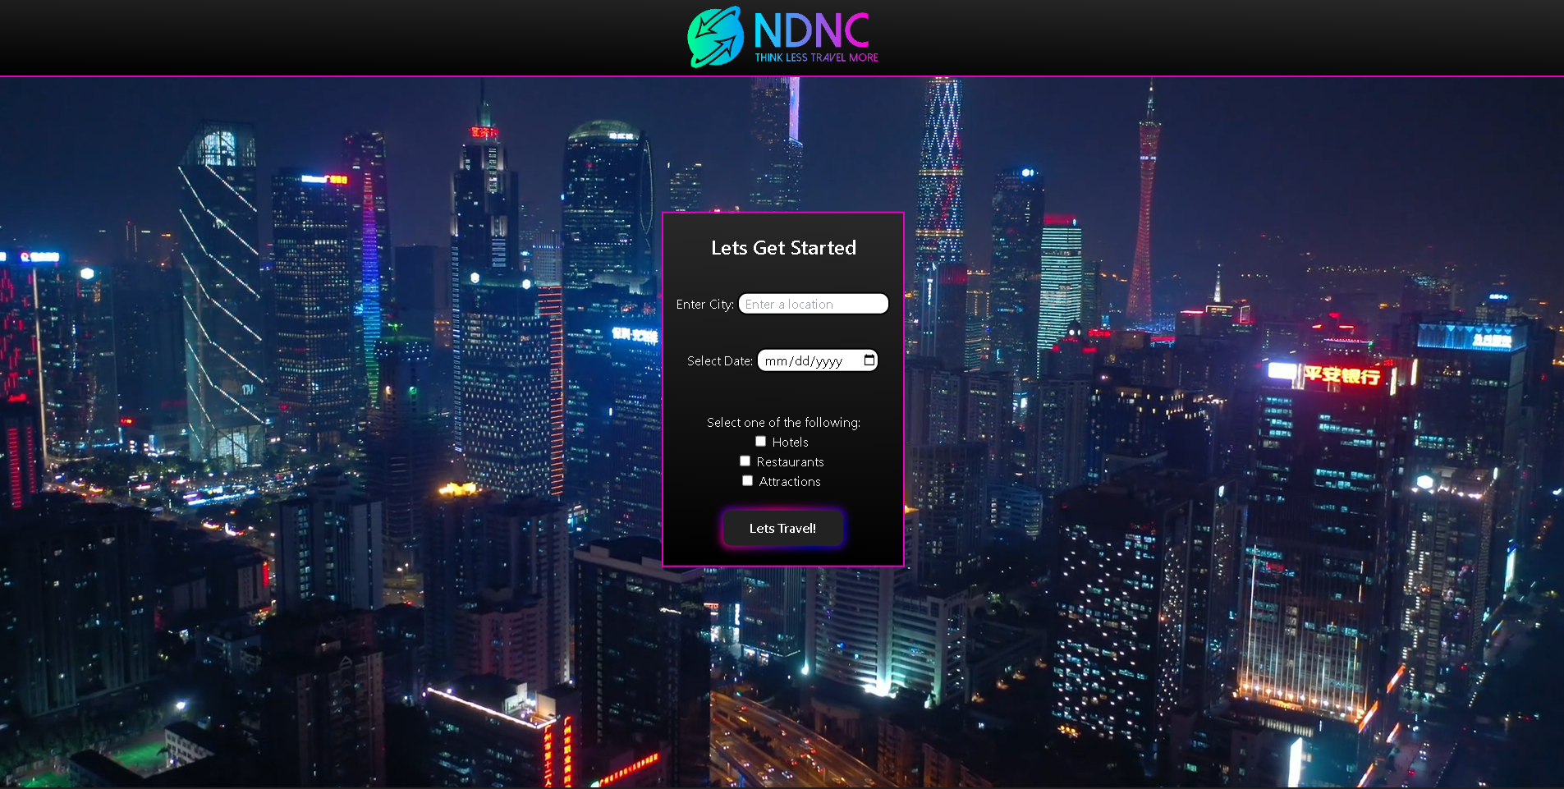

Slide 4
Concept
AS A world traveler.
I WANT to be able to access information about the next city I want to visit with the click of a button.
SO THAT I can plan my day around the attractions and restaurants I want to visit without having to go to multiple sites.

Slide 5
Process (Tasks)
HTML/CSS - Make the HTML structure and use CSS/Tailwind to make the webpage visually attractive and responsive.
Local Storage – Make a Local Storage for previously searched cities, and to display upon clicking to input another city in the form.
API Requests/HTML Relocation – Fetch API Requests and assign elements on the HTML for the retrieved data.

Slide 6
Process (APIs)
APIs used:
Google Maps – Used to autocomplete the traveler's city input on the city form, also used to display a map of Hotels, Restaurants and Attractions in the searched city.
OpenWeather – Used to pull latitude and longitude of searched city to use for Amadeus search query.
Amadeus – Used to find Hotels, Restaurants and Attractions within a certain distance of the searched city.

Slide 7
Process (Successes/Challenges)
Successes:
Workflow – The workflow of assigned tasks on the Kankan board was easy to understand and never conflicted with each others' tasks.
Challenges:
API setup – Spent too much time finding the right API since most APIs we tried using are now dead or had API key issues.

Slide 8
Future Development for NDNC
The current Amadeus API does not allow fetch calls for Hotels prices and its currently in development.
Once we can test on the web, we can use the TripAdvisor API to replace Amadeus to make a fully functional booking website.

Slide 9
Link
https://anthonyfrederick7.github.io/New-Day-New-City/

